Slide 1
2024-03-08, SEM-05, washing times
Gottfrid Olsson, samples Q, R, S, T, U

Slide 2
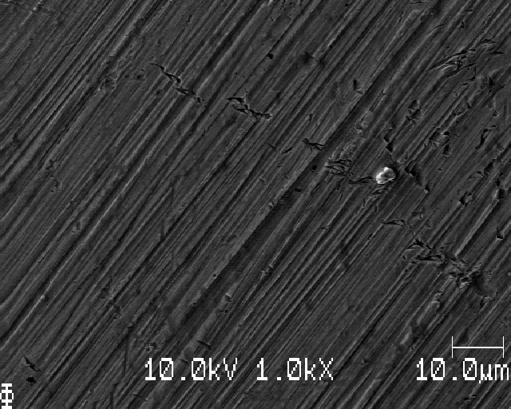
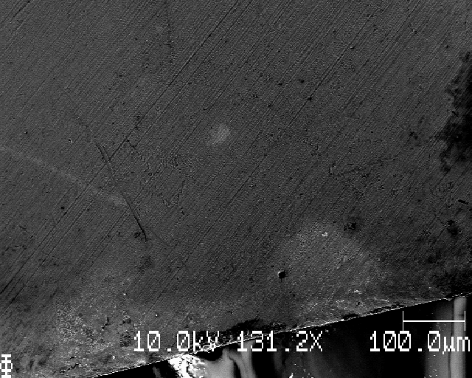
Testbilder 10kV1nA

Slide 3
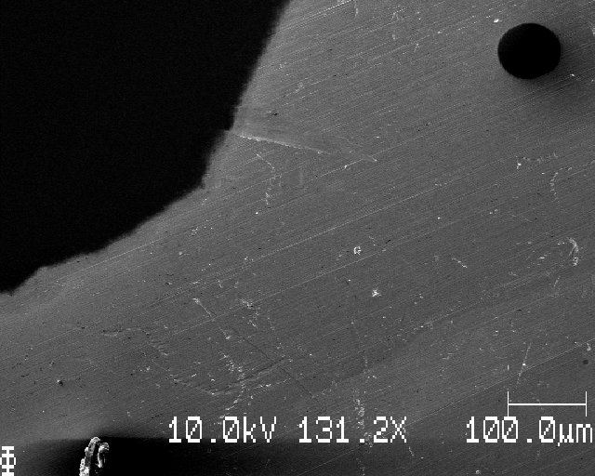
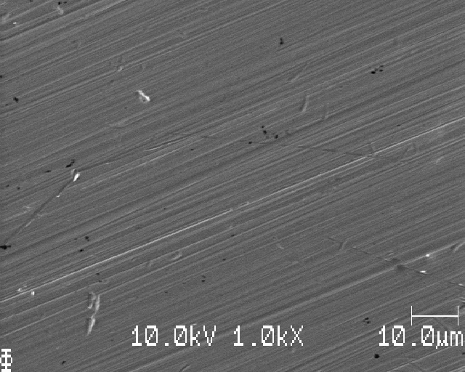
Sample Q: electrolyte on surface, no wash

Slide 4
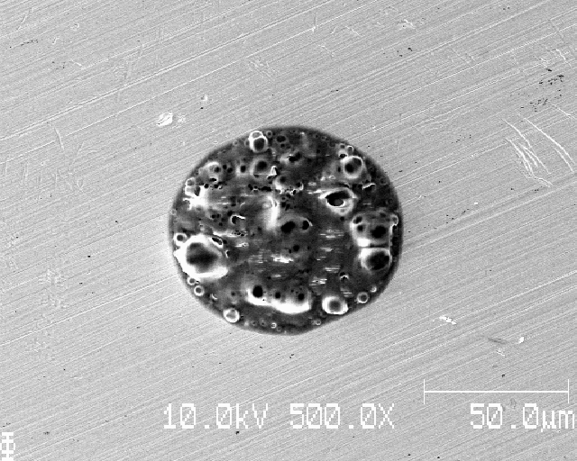
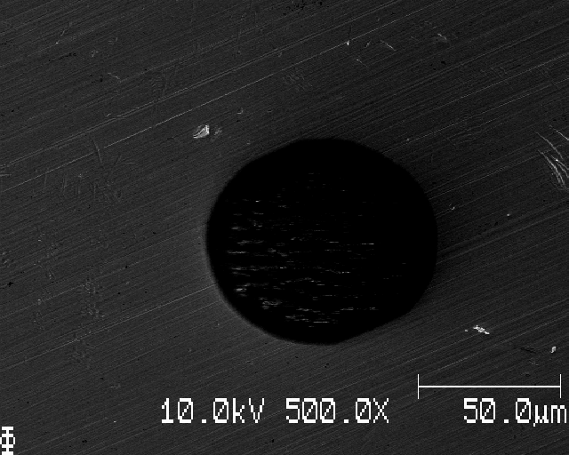
Black hole? Saw bubbles! Electrolyte/DME

Slide 5
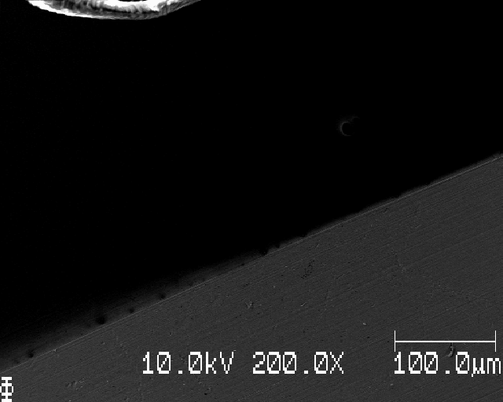
Edge of where electrolyte was applied /- black space is probably DME then

Slide 6
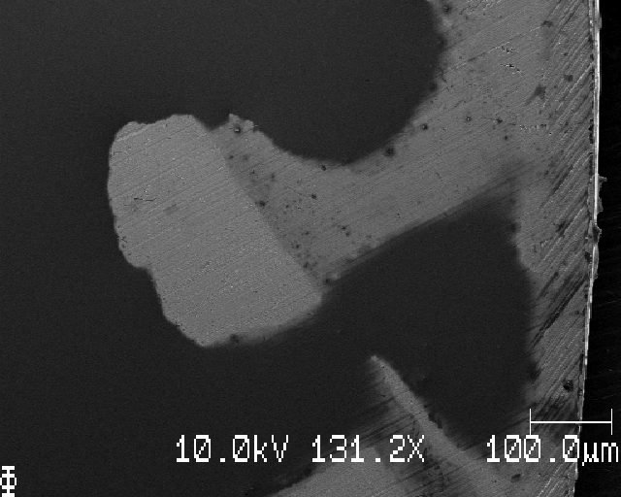
Edge of sample, areas of both electrolyte and clean Cu

Slide 7
Must clean in someway, otherwise cannot see anything!

Slide 8
Sample R: electrolyte on surface, 1 min wash submerged in fresh DME

Slide 9
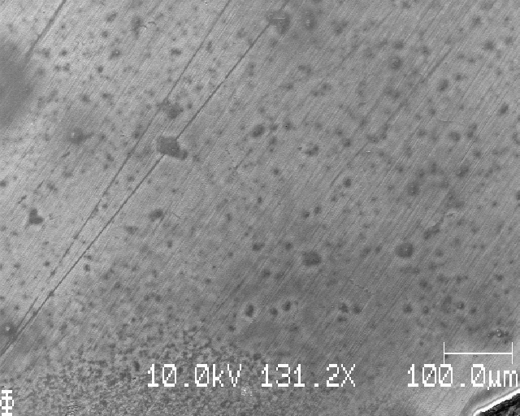
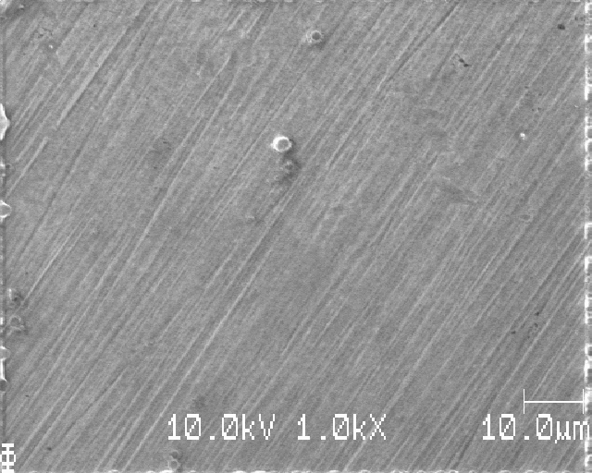
Close to cut edge (middle), dark spots and bubbles?

Slide 10
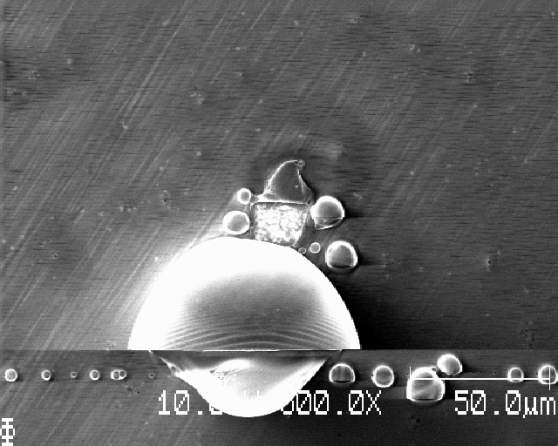
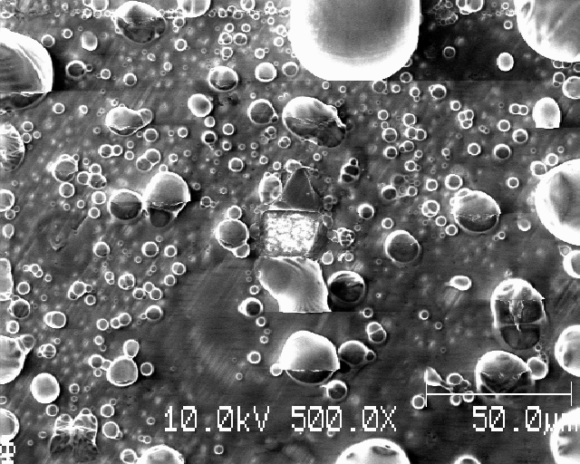
If zoom in, lots of bubbles (same place, different times) – still DME from washing on surface?

Slide 11
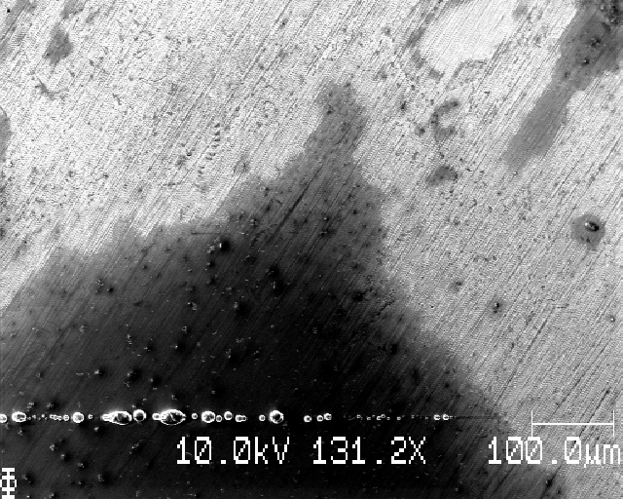
Changed to 10kV5nA

Slide 12
Hrrm, looks bad even though it was submerged in DME for 1 minute

Slide 13
Sample S: Li-deposition, submerged in DME for 10 seconds

Slide 14
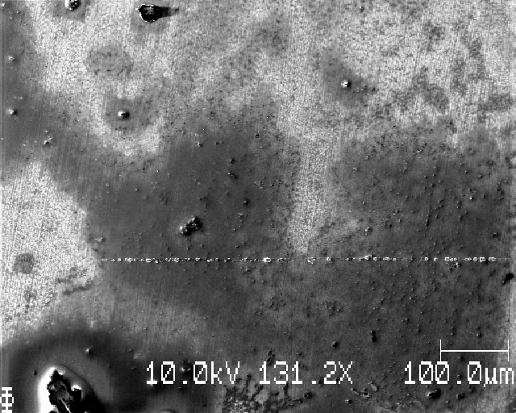
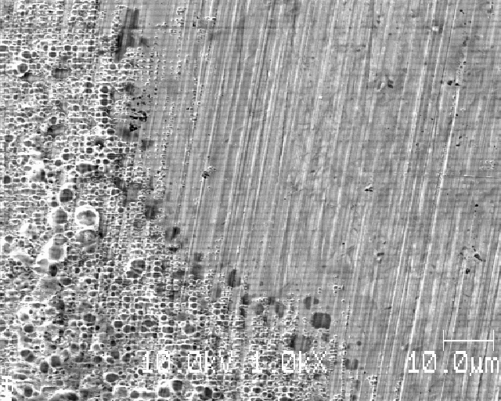
Edge of sample

Slide 15
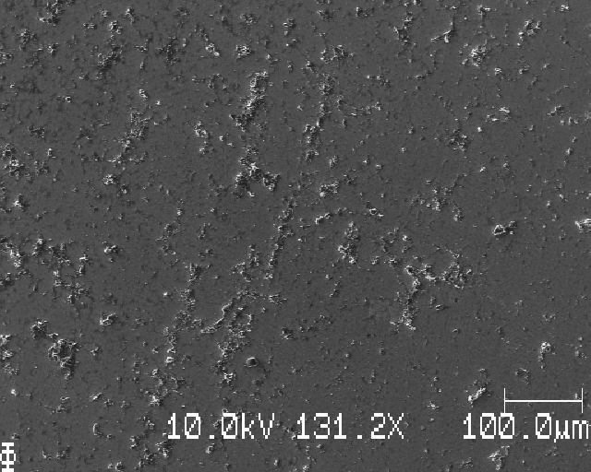
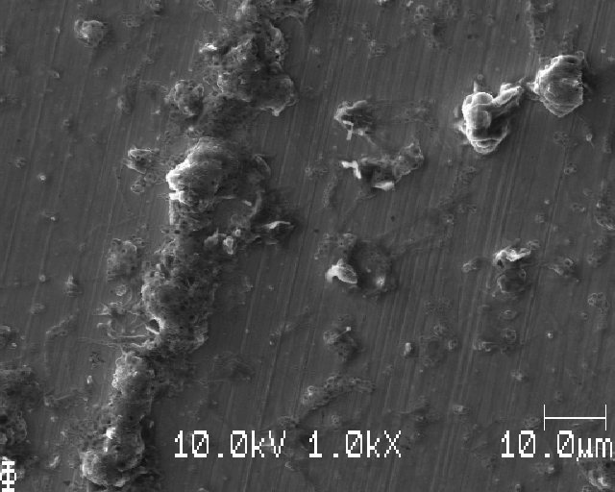
Further in towards centre: salt/DME (bubbles)

Slide 16
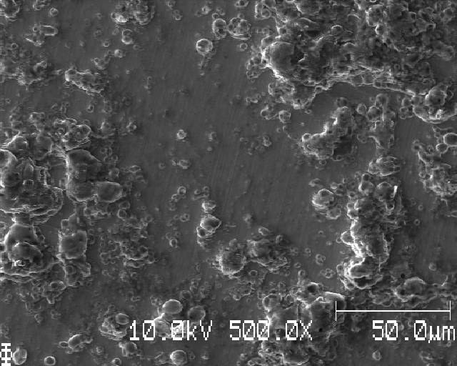
Even if there is Li deposition, everything is covered in shite

Slide 17
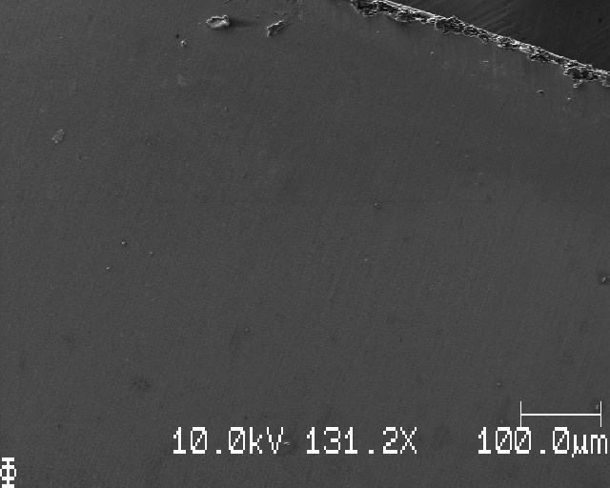
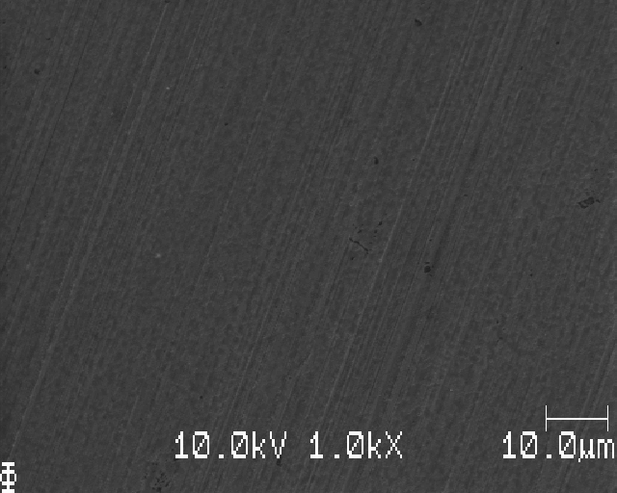
Close to edge, bare Cu

Slide 18
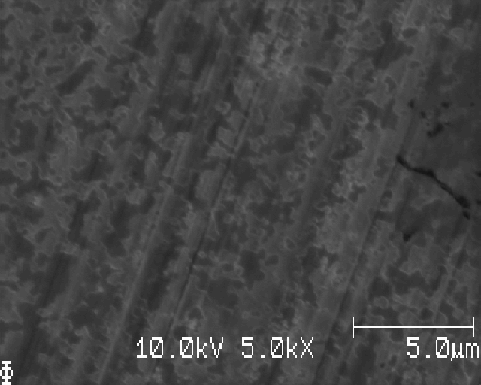
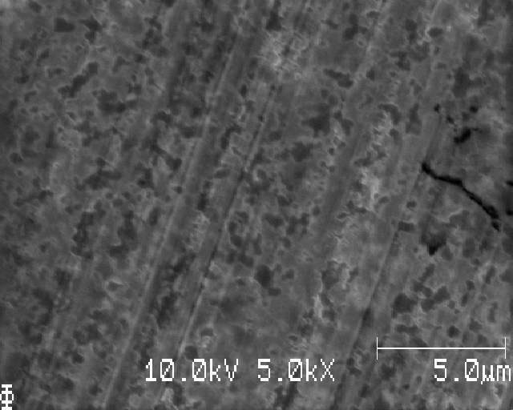
Dead Li? (further zoom in on previous image):changed brightness and contrast for these two

Slide 19
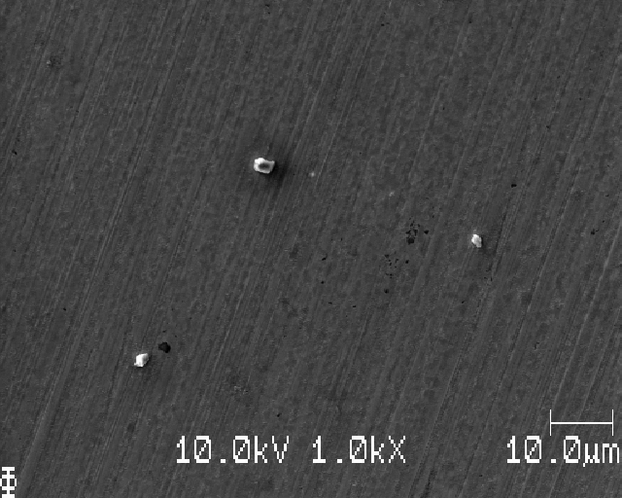
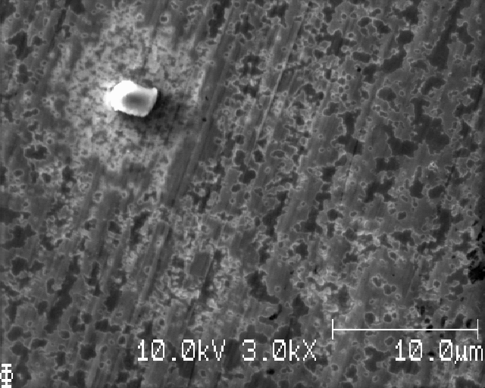
Something’s happening when you look at a place for long

Slide 20
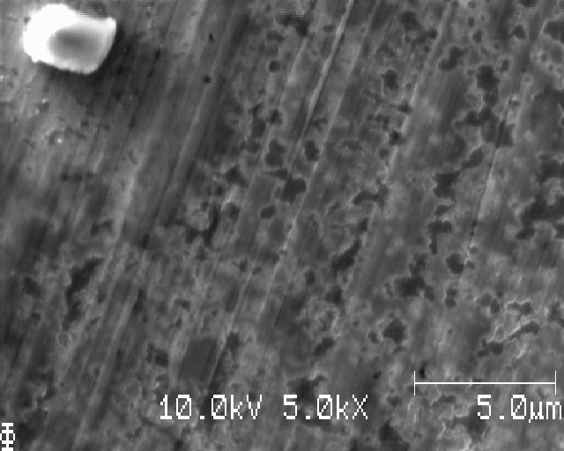
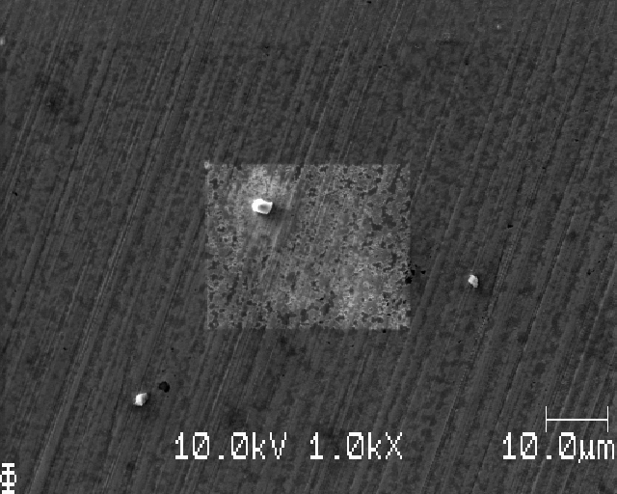
Something’s happening when you look at a place for long

Slide 21
A lot of shite, seems like 10 seconds wash (submerged in DME) is not enough

Slide 22
Sample T: Li-deposition, submerged in DME for 1 minute
10kV10nA

Slide 23
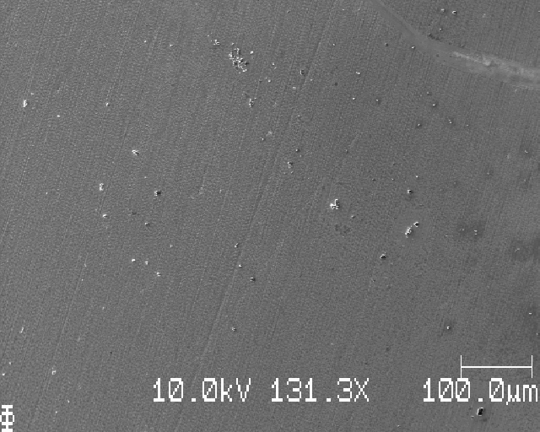
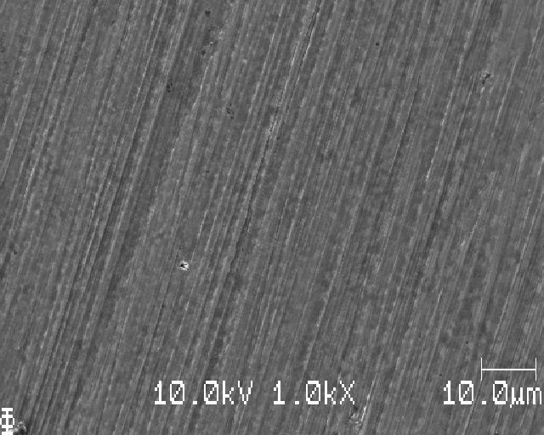
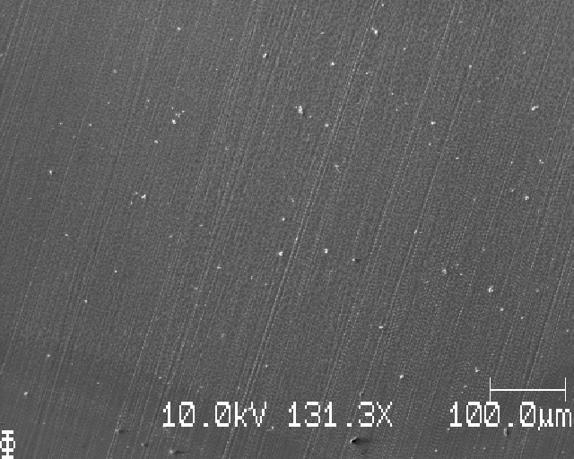
Close to edge

Slide 24
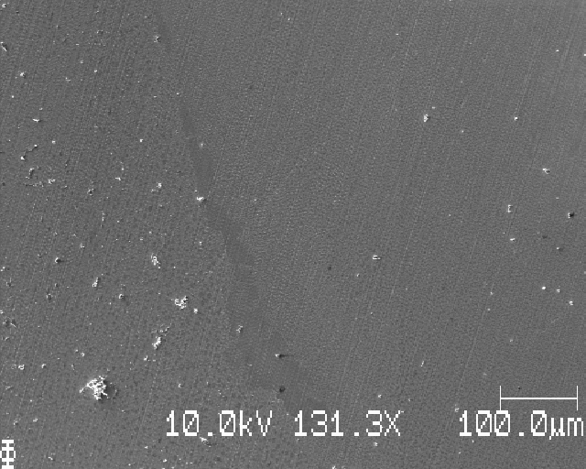
Granslandet mellan kant (right) och mitten, deponering (left)

Slide 25
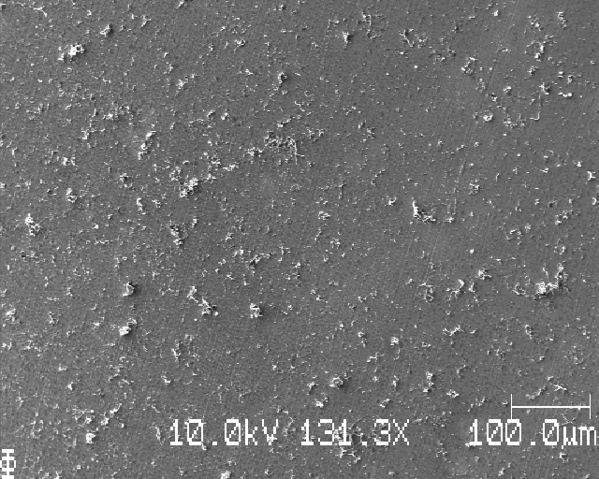
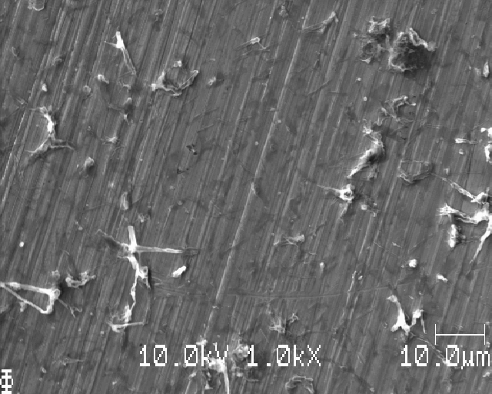
Li-deposition

Slide 26
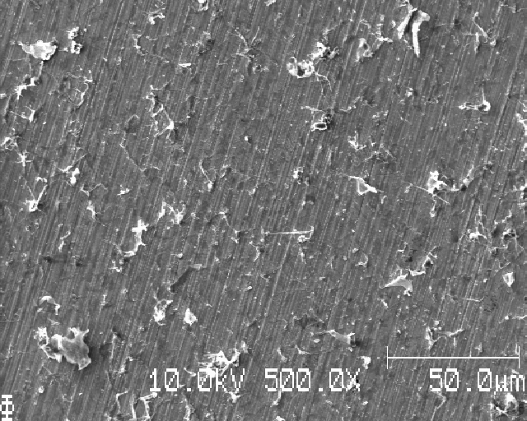
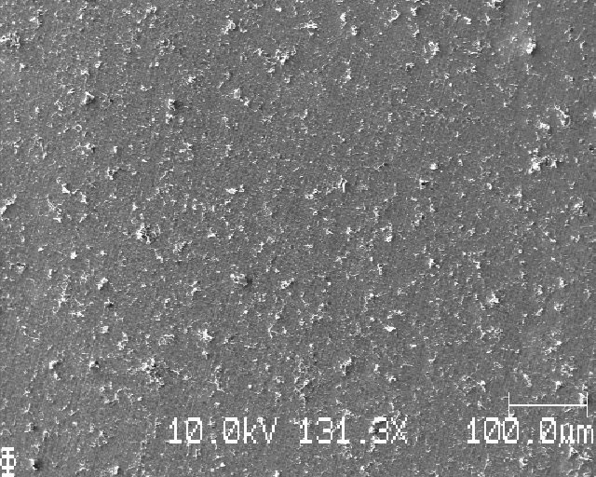
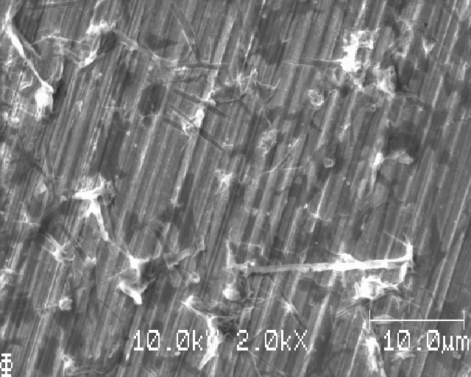
Center

Slide 27
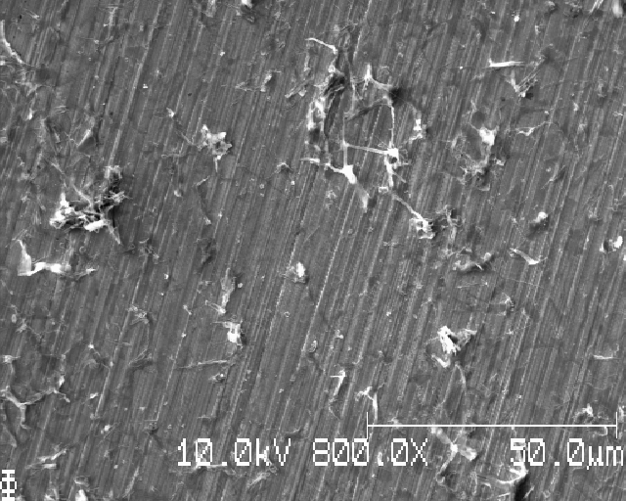
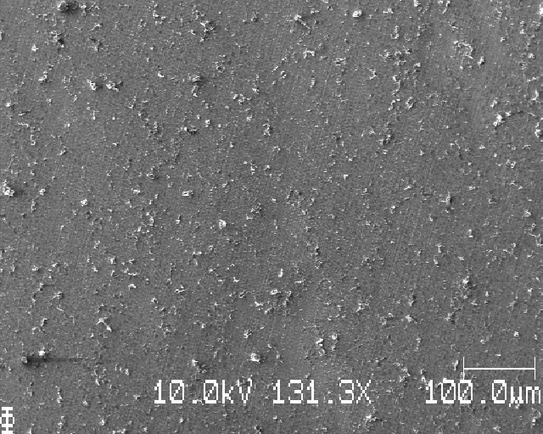
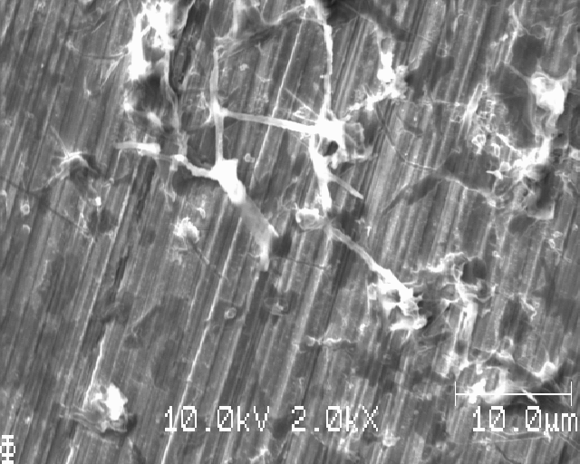
Center, different place

Slide 28
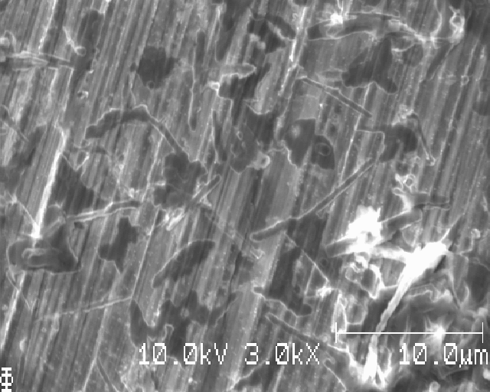
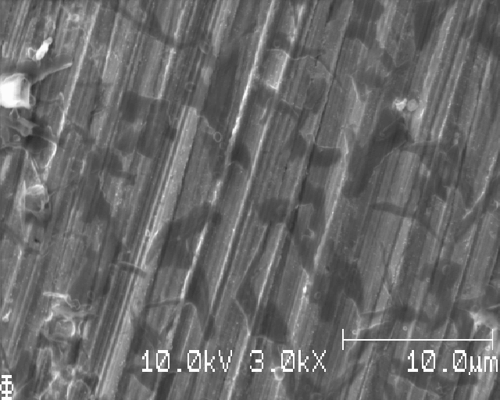

Slide 29
Li deposition, no shite (or very little)
→ 1 minute might be enough washing
BUT! Still dark spots in the background – eaten Li from washing in DME?

Slide 30
Sample U: Li-deposition, submerged in DME for 5 minutes (Li might have delaminated from metal plunger during assembly, so bad or irregular Li-deposition should not be surprising)

Slide 31
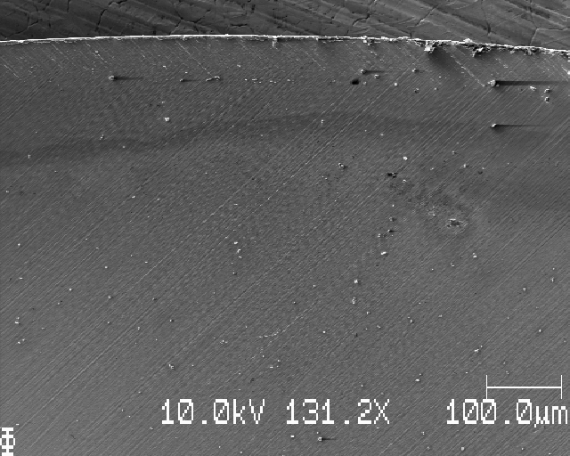
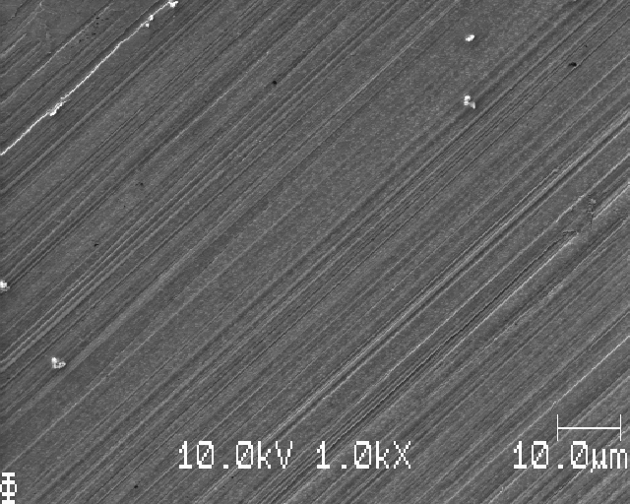
At edge

Slide 32
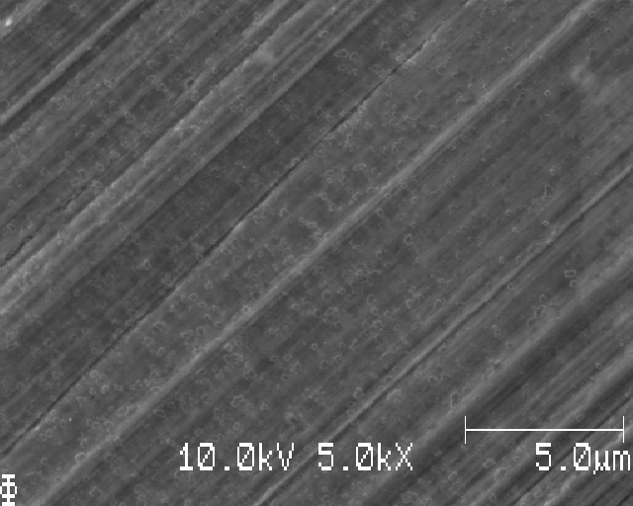
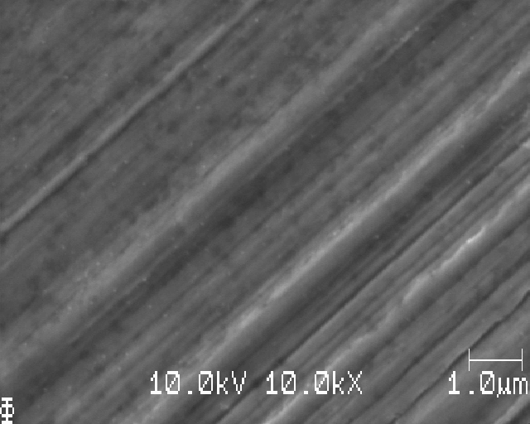
At edge, more zoom (need better focusing…)

Slide 33
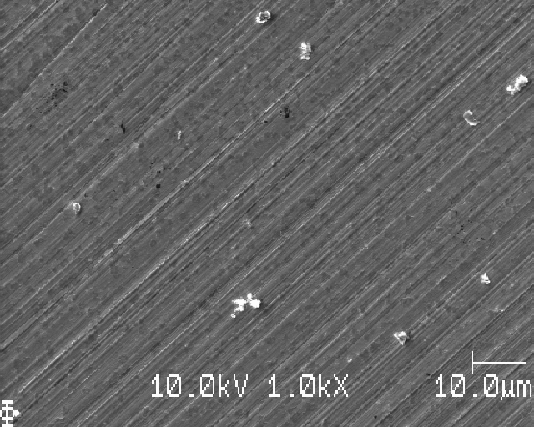
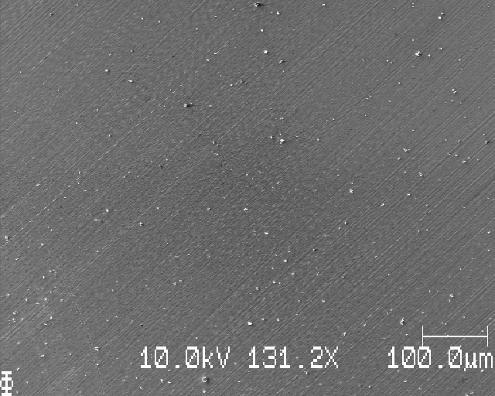
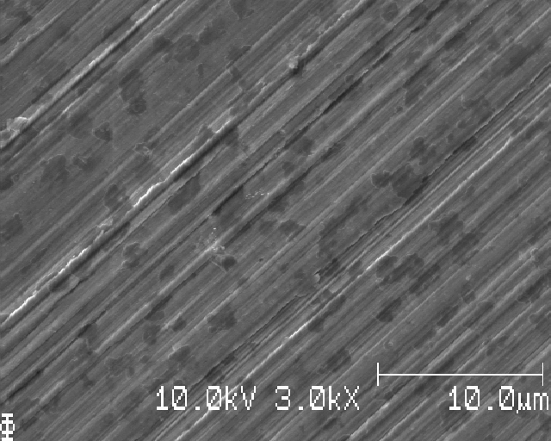
1mm from edge

Slide 34
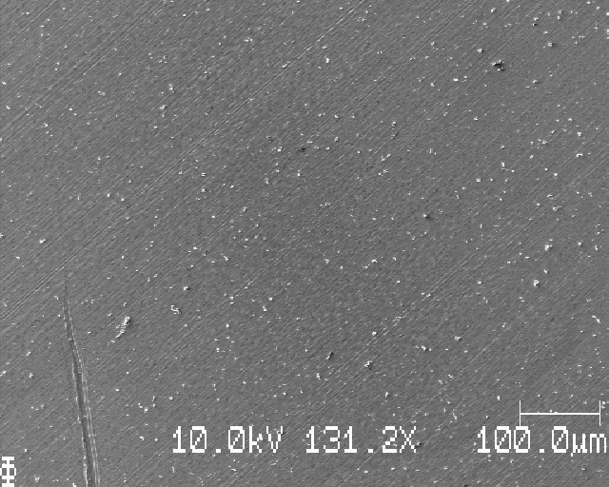
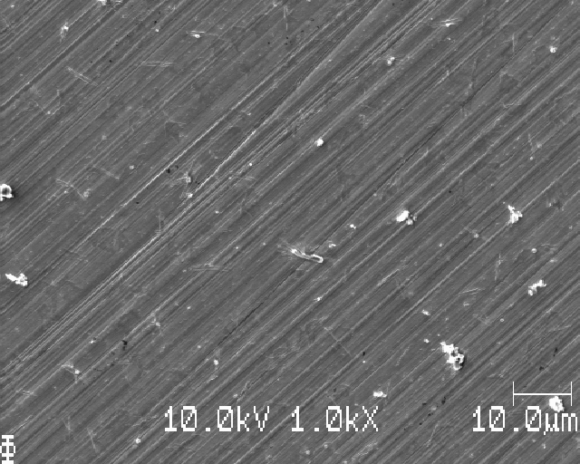
2-3mm in

Slide 35
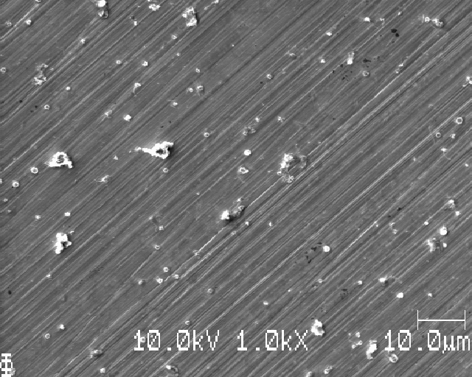


Close to center 4-5 mm from edge

Slide 36


Further down, even further down (looks the same)

Slide 37


Slide 38
Looks very much more homogenous Li deposition (even though it might be very much to little)
No shite everywhere! – longer washing time better(?), at least longer than 10 seconds

